Slide 1
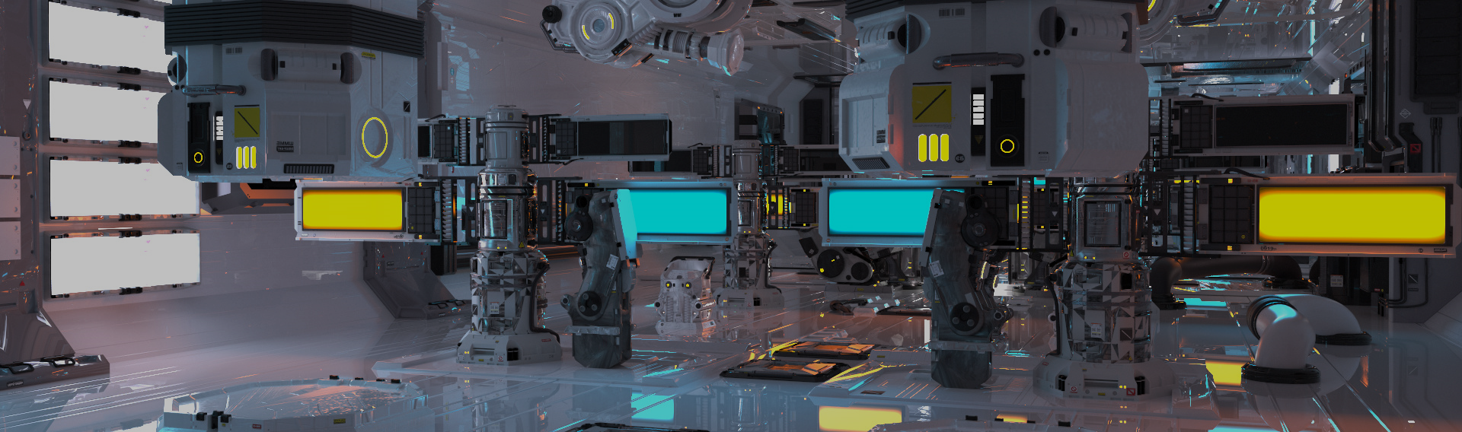
Roller Coaster 2
電腦圖學導論實習
Computer Graphics Lab | NTUST CSIE

Slide 2
Overview
Orientation correctness
Lighting
Directional light
Point light
Spot light
Modeling
Homework

Slide 3
Orientation Correctness

Slide 4
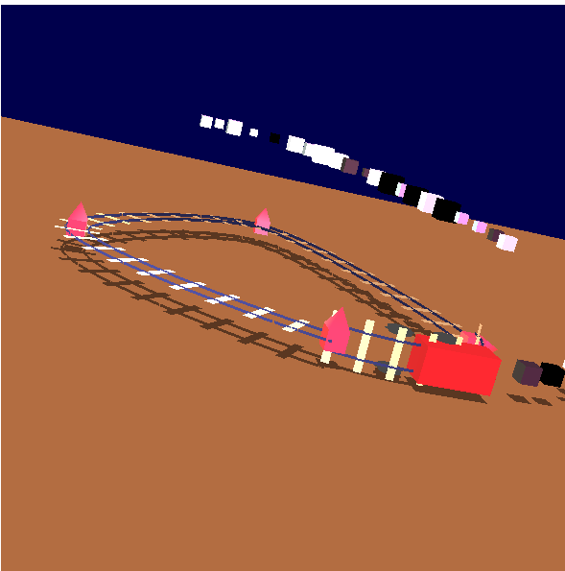
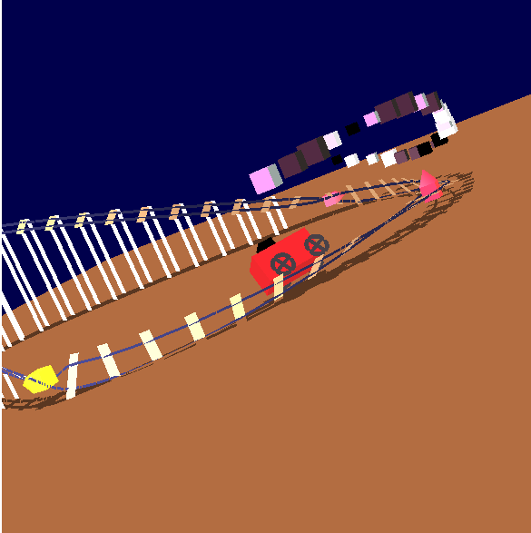
Orientation correctness
Be careful with your orientation
For both car and rail
without interpolation
with interpolation

Slide 5
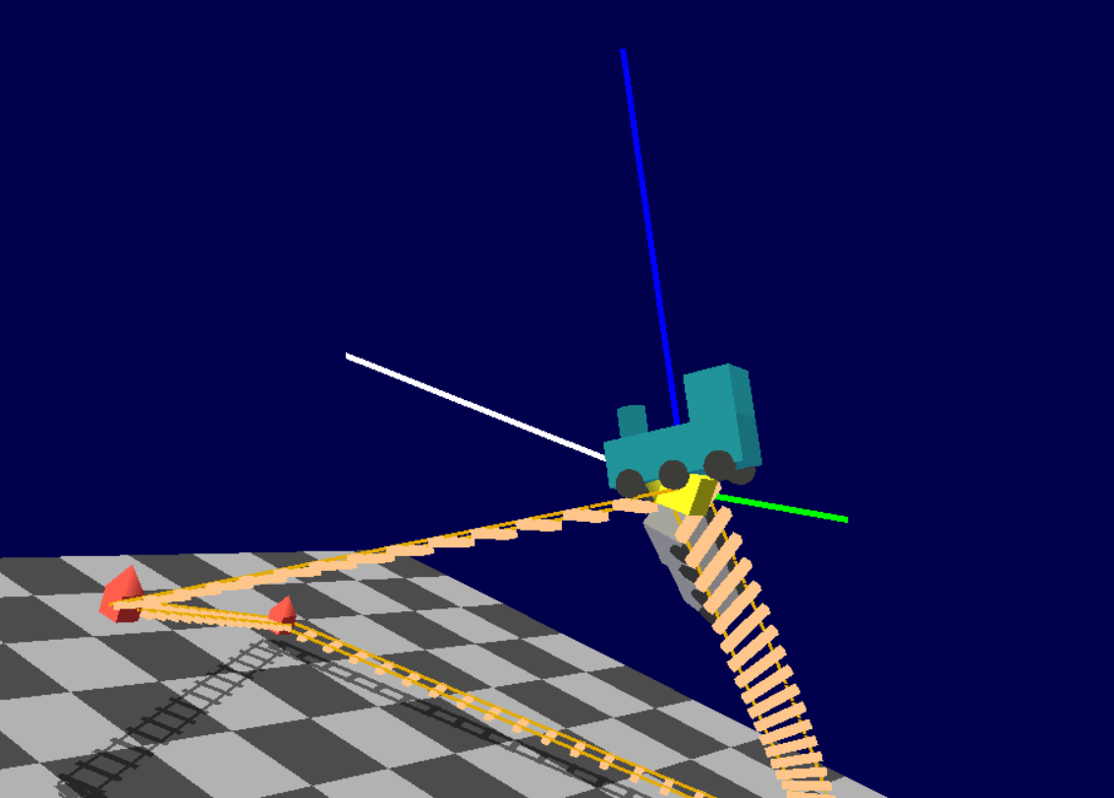
Correct Case for Linear
int T = (int)t_time;
float t = t_time - T;
Pnt3f cp_pos_p1 = m_pTrack->points[T].pos;
Pnt3f cp_pos_p2 =
m_pTrack->points[(T + 1) % m_pTrack->points.size()].pos;
// orient
Pnt3f cp_orient_p1 = m_pTrack->points[T].orient;
Pnt3f cp_orient_p2 =
m_pTrack->points[(T + 1) % m_pTrack->points.size()].orient;
Pnt3f qt = (1 - t) * cp_pos_p1 + t * cp_pos_p2;
Pnt3f orient_t = (1 - t) * cp_orient_p1 + t * cp_orient_p2;
Pnt3f u = (cp_pos_p2 - cp_pos_p1); u.normalize();
Pnt3f w = u * orient_t; w.normalize();
Pnt3f v = w * u; v.normalize();

Slide 6
Correct Case for Linear
float rotation[16] = {
u.x, u.y, u.z, 0.0,
v.x, v.y, v.z, 0.0,
w.x, w.y, w.z, 0.0,
0.0, 0.0, 0.0, 1.0
};
glPushMatrix();
glTranslatef(qt.x, qt.y, qt.z);
glMultMatrixf(rotation);
glScalef(5.0f, 5.0f, 5.0f);
glTranslatef(-0.5f, -0.5f, -0.5f);
draw_cube(doingShadows);
glPopMatrix();
Notes:
火車 / 枕木 / 鐵軌 都要正確

Slide 7
Lighting

Slide 8

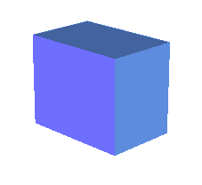
Lighting
Notes:
Local: 只看光源與計算物體本身的交互反映
Global: 考慮物體對物體的影響

Slide 9
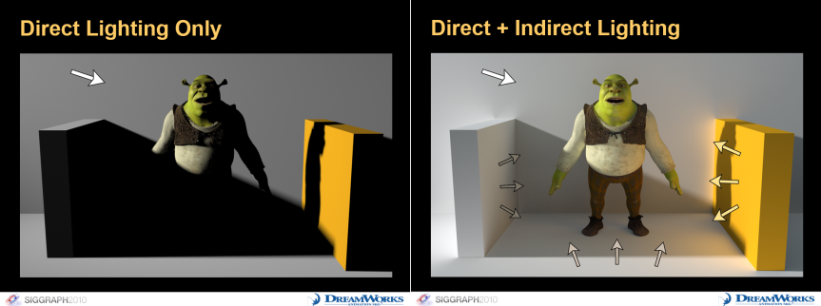
Local vs. Global Models
Notes:
Local: 只看光源與計算物體本身的交互反映
Global: 考慮物體對物體的影響

Slide 10
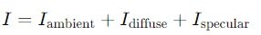
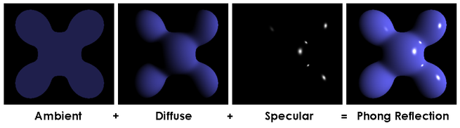
Lighting in OpenGL legacy pipeline
Base on phong shading
Fixed light parameter
Notes:
Ambient: Hack環境內的光帶來的常量光亮
Diffuse: 愈是正面對光源的face愈亮
Specular: 反射方向與視角夾角愈小則愈亮

Slide 11
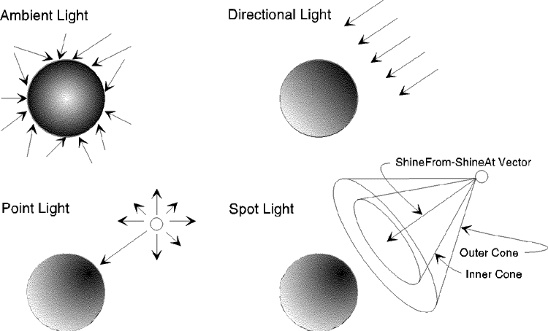
Lighting
Notes:
Ambient: Hack環境內的光帶來的常量光亮
Diffuse: 愈是正面對光源的face愈亮
Specular: 反射方向與視角夾角愈小則愈亮

Slide 12
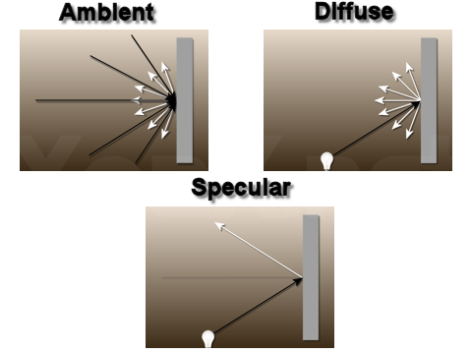
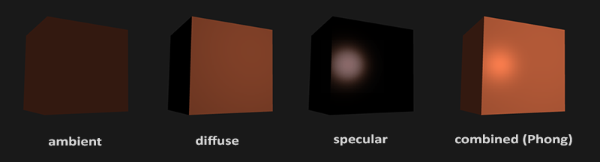
Lighting
Ambient
Micro light from all direction
Diffuse
Reflect light to all direction equally from light source
Specular
Reflection from smooth surface, i.e., light goes out in a concentrated way
Notes:
Ambient: Hack環境內的光帶來的常量光亮
Diffuse: 愈是正面對光源的face愈亮
Specular: 反射方向與視角夾角愈小則愈亮

Slide 13
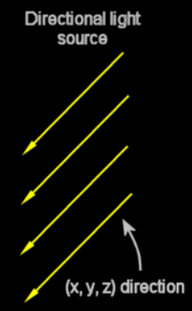
Directional Light
float noAmbient[] = {0.0f, 0.0f, 0.0f, 1.0f}; float whiteDiffuse[] = {1.0f, 1.0f, 1.0f, 1.0f}; /* * Directional light source (w = 0) * The light source is at an infinite distance, * all the ray are parallel and have the direction (x, y, z). */ float position[] = {1.0f, 1.0f, 0.0f, 0.0f}; glLightfv(GL_LIGHT0, GL_AMBIENT, noAmbient); glLightfv(GL_LIGHT0, GL_DIFFUSE, whiteDiffuse); glLightfv(GL_LIGHT0, GL_POSITION, position);
Notes:
https://www.just.edu.jo/~yaser/courses/cs480/Tutorials/OpenGl%20-%20Light%20Part%20II.htm
w = 0 (無限遠)

Slide 14
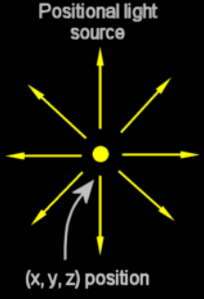
Point Light
float yellowAmbientDiffuse[] = {1.0f, 1.0f, 0.0f, 1.0f}; /* * Positional light source (w = 1) * The light source is positioned at (x, y, z). * The ray come from this particular location (x, y, z) and goes towards all directions. */ float position[] = {-2.0f, 2.0f, -5.0f, 1.0f}; glLightfv(GL_LIGHT1, GL_AMBIENT, yellowAmbientDiffuse); glLightfv(GL_LIGHT1, GL_DIFFUSE, yellowAmbientDiffuse); glLightfv(GL_LIGHT1, GL_POSITION, position);
Notes:
https://www.just.edu.jo/~yaser/courses/cs480/Tutorials/OpenGl%20-%20Light%20Part%20II.htm
w = 1 (世界座標)
GL_xx_ATTENUATION: 衰減率

Slide 15
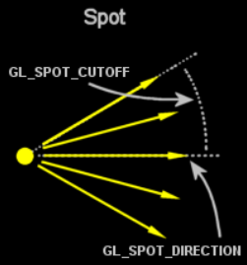
Spot Light
float noAmbient[] = {0.0f, 0.0f, 0.2f, 1.0f}; //low ambient light float diffuse[] = {0.0f, 0.0f, 1.0f, 1.0f}; float position[] = {0.0f, 0.0f, 0.0f, 1.0f}; //properties of the light glLightfv(GL_LIGHT2, GL_AMBIENT, noAmbient); glLightfv(GL_LIGHT2, GL_DIFFUSE, diffuse); glLightfv(GL_LIGHT2, GL_POSITION, position); /*Spot properties*/ //spot direction float direction[] = {xSpotDir, ySpotDir, zOffset}; glLightfv(GL_LIGHT2, GL_SPOT_DIRECTION, direction); //angle of the cone light emitted by the spot : value between 0 to 180 float spotCutOff = 45 glLightf(GL_LIGHT2, GL_SPOT_CUTOFF, spotCutOff); //exponent propertie defines the concentration of the light glLightf(GL_LIGHT2, GL_SPOT_EXPONENT, 15.0f); //light attenuation (default values used here : no attenuation with the distance) glLightf(GL_LIGHT2, GL_CONSTANT_ATTENUATION, 1.0f); glLightf(GL_LIGHT2, GL_LINEAR_ATTENUATION, 0.0f); glLightf(GL_LIGHT2, GL_QUADRATIC_ATTENUATION, 0.0f);
Notes:
https://www.just.edu.jo/~yaser/courses/cs480/Tutorials/OpenGl%20-%20Light%20Part%20II.htm
GL_xx_ATTENUATION: 衰減率

Slide 16
Modeling

Slide 17
Modeling
We have once talked about the capability of the model space.
Now, let’s talk about model.
Two way to integrate model with program
Hard coded
Software format
Notes:
Ambient: Hack環境內的光帶來的常量光亮
Diffuse: 愈是正面對光源的face愈亮
Specular: 反射方向與視角夾角愈小則愈亮

Slide 18
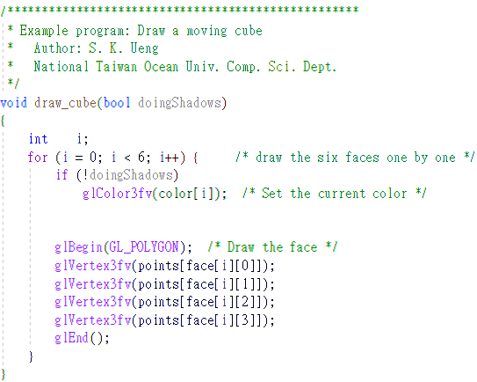
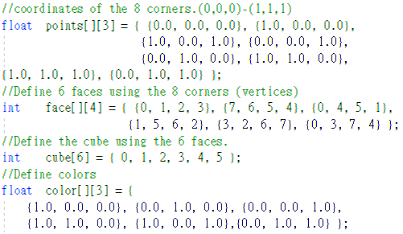
Modeling(Hard Code)
Notes:
繪製前只需更動ModelMatrix
不需自己計算轉換到世界座標後每個節點的位置

Slide 19
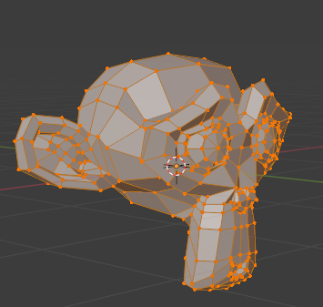
Modeling(Software)
Blender, Maya…
Format
.obj
.fbx
.x3d
Parser
Rendering
GL fixed pipeline
GL flexible pipeline
Notes:
Parse info to CPU memory(vertices, faces, normal, textures)
Bind data to GPU memory

Slide 20
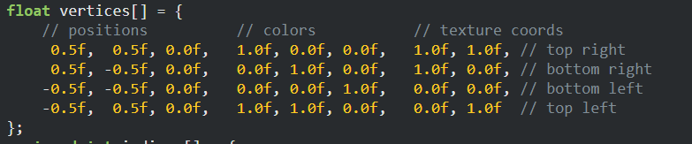
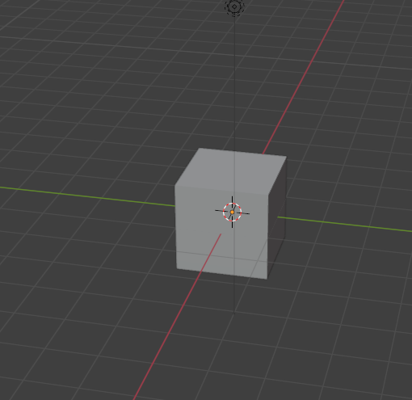
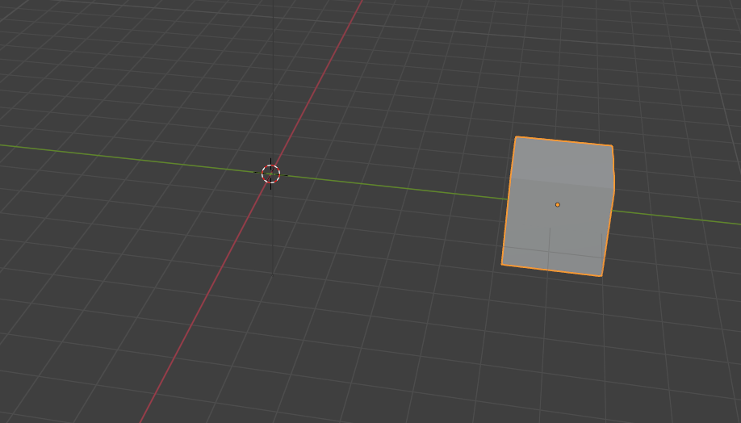
Model Space
You don’t have to change model to move them
You move the model by model matrix(transform from model space to world)
But transform the space. Inspect how coordinate origin is changing
Don’t change this

Slide 21
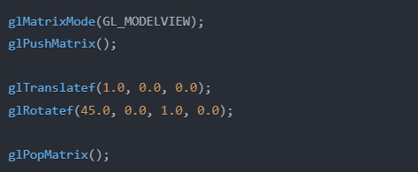
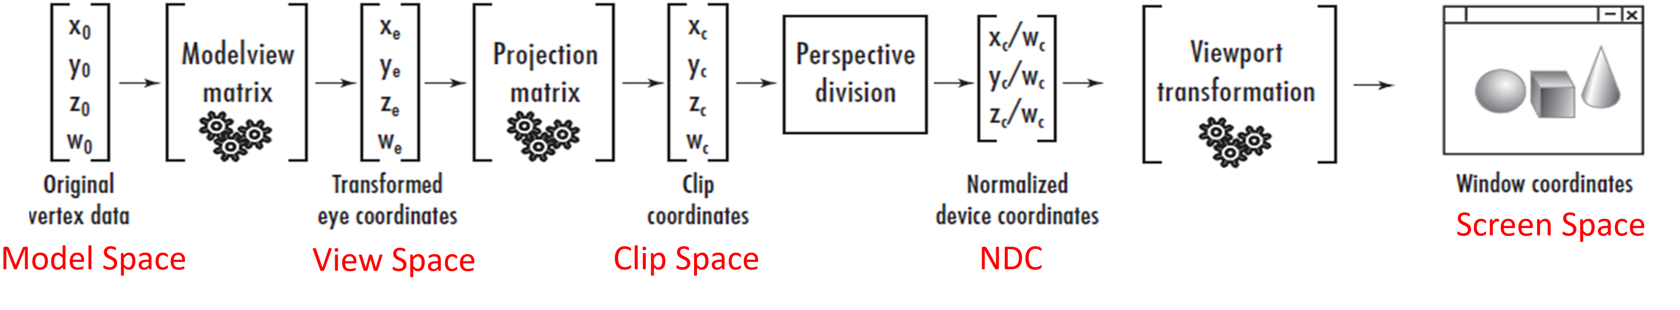
Transform Code
Recall that how we setup those transform matrix
We can add more matrix on them
Draw model here

Slide 22
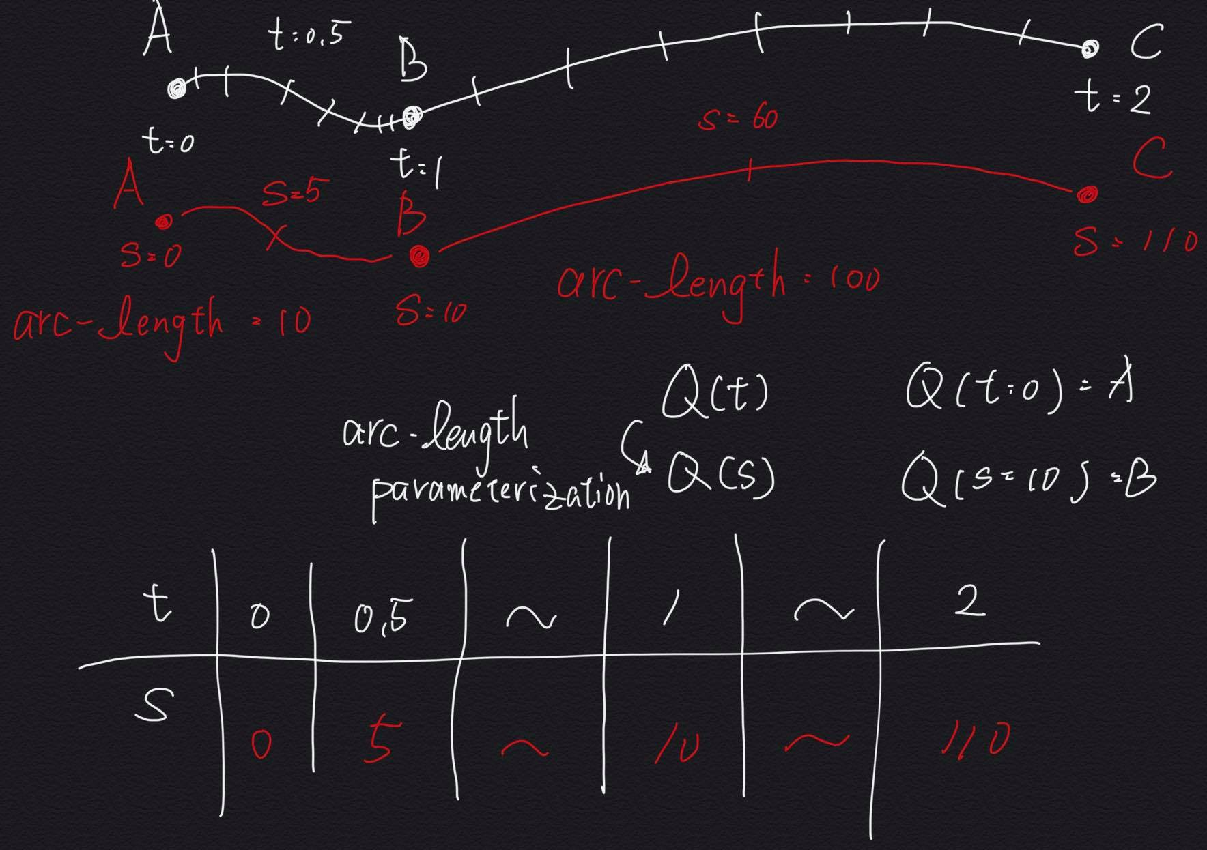
Arc-length parameterization
Changing from moving by parameter T to moving by “Length”.
T: 0~1
S(Length): Depends on actual distance

Slide 23
Recommendation Reading
https://medium.com/maochinn/fltk-project-roller-coasters-f488c70dd7e9

Slide 24
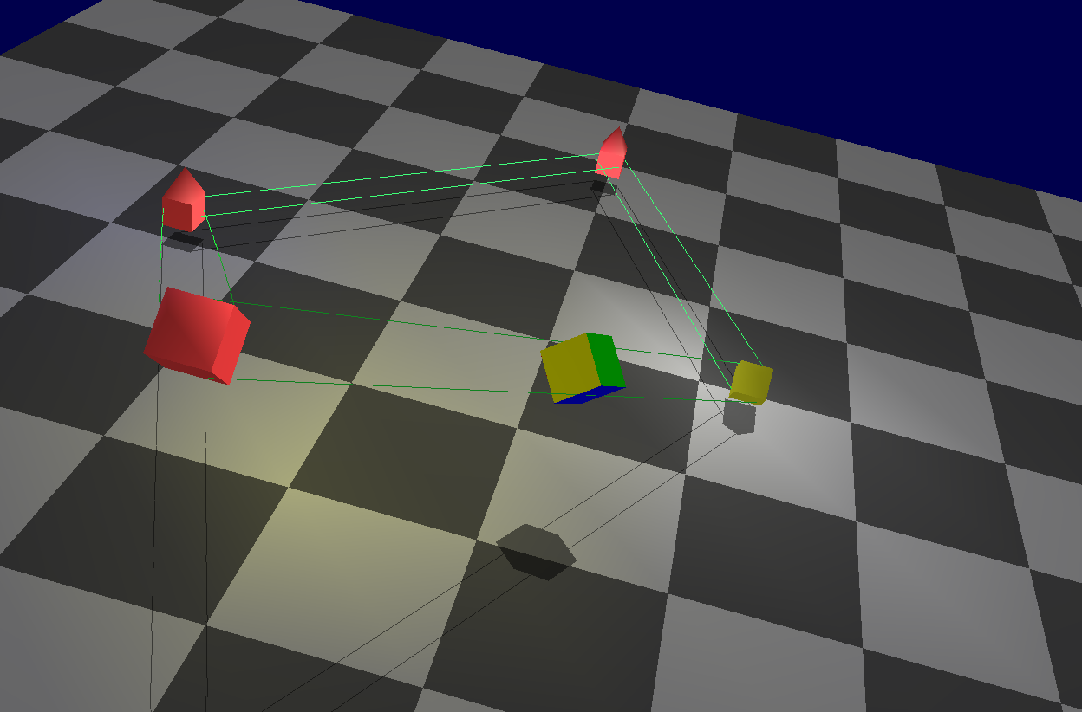
Hw07
Draw CORRECT curve track, sleeper and train
Linear
Cardinal(2%)
B-Spline(1%)
Lighting
Directional(2%)
Point or Spot(2%)
Arc-length parameterization (4%)
Notes:
測試: 火車正面改色 並且保持正確方向
Point light / Spot 將位置綁在控制點上(隨控制點移動)

